Slide 1

Brainbox: An Online Quiz Platform for Education
Java full-stack project.

Slide 2

presented by :
V. Gowtham Bhaskar
S. Hemanth Sai
M. Sruthi
V. Niroop
L. Vinutha kumari

Slide 3

Problem Statement
1
Time-consuming Manual Grading
2
Limited Flexibility in Scheduling
3
Lack of Personalized Assessment
4
Difficulty in providing immediate feedback

Slide 4

Abstract
Our project aims to develop an online quiz platform using Java full-stack development to modernize exam processes in schools and colleges. The platform will allow teachers to create and conduct online assessments, saving time on manual correction. It includes user authentication, a database for storing questions and answers, and features like a leaderboard and adaptive learning algorithms. Students can take quizzes at their convenience, and the platform also allows the student to adjust question difficulty based on his/her knowledge on a particular subject, providing a personalized learning experience. We will use HTML, CSS, JavaScript for the front end, Java for the backend, and a database for data storage.

Slide 5

Our Solution
User-friendly Interface
Efficient Quiz Management
Adaptive Learning Algorithms
Intuitive platform design for seamless navigation and interaction for both teachers and students.
Streamlined process for quiz creation, administration, and real-time progress tracking.
Personalize question difficulty to cater to individual student competencies, fostering a personalized learning journey.

Slide 6
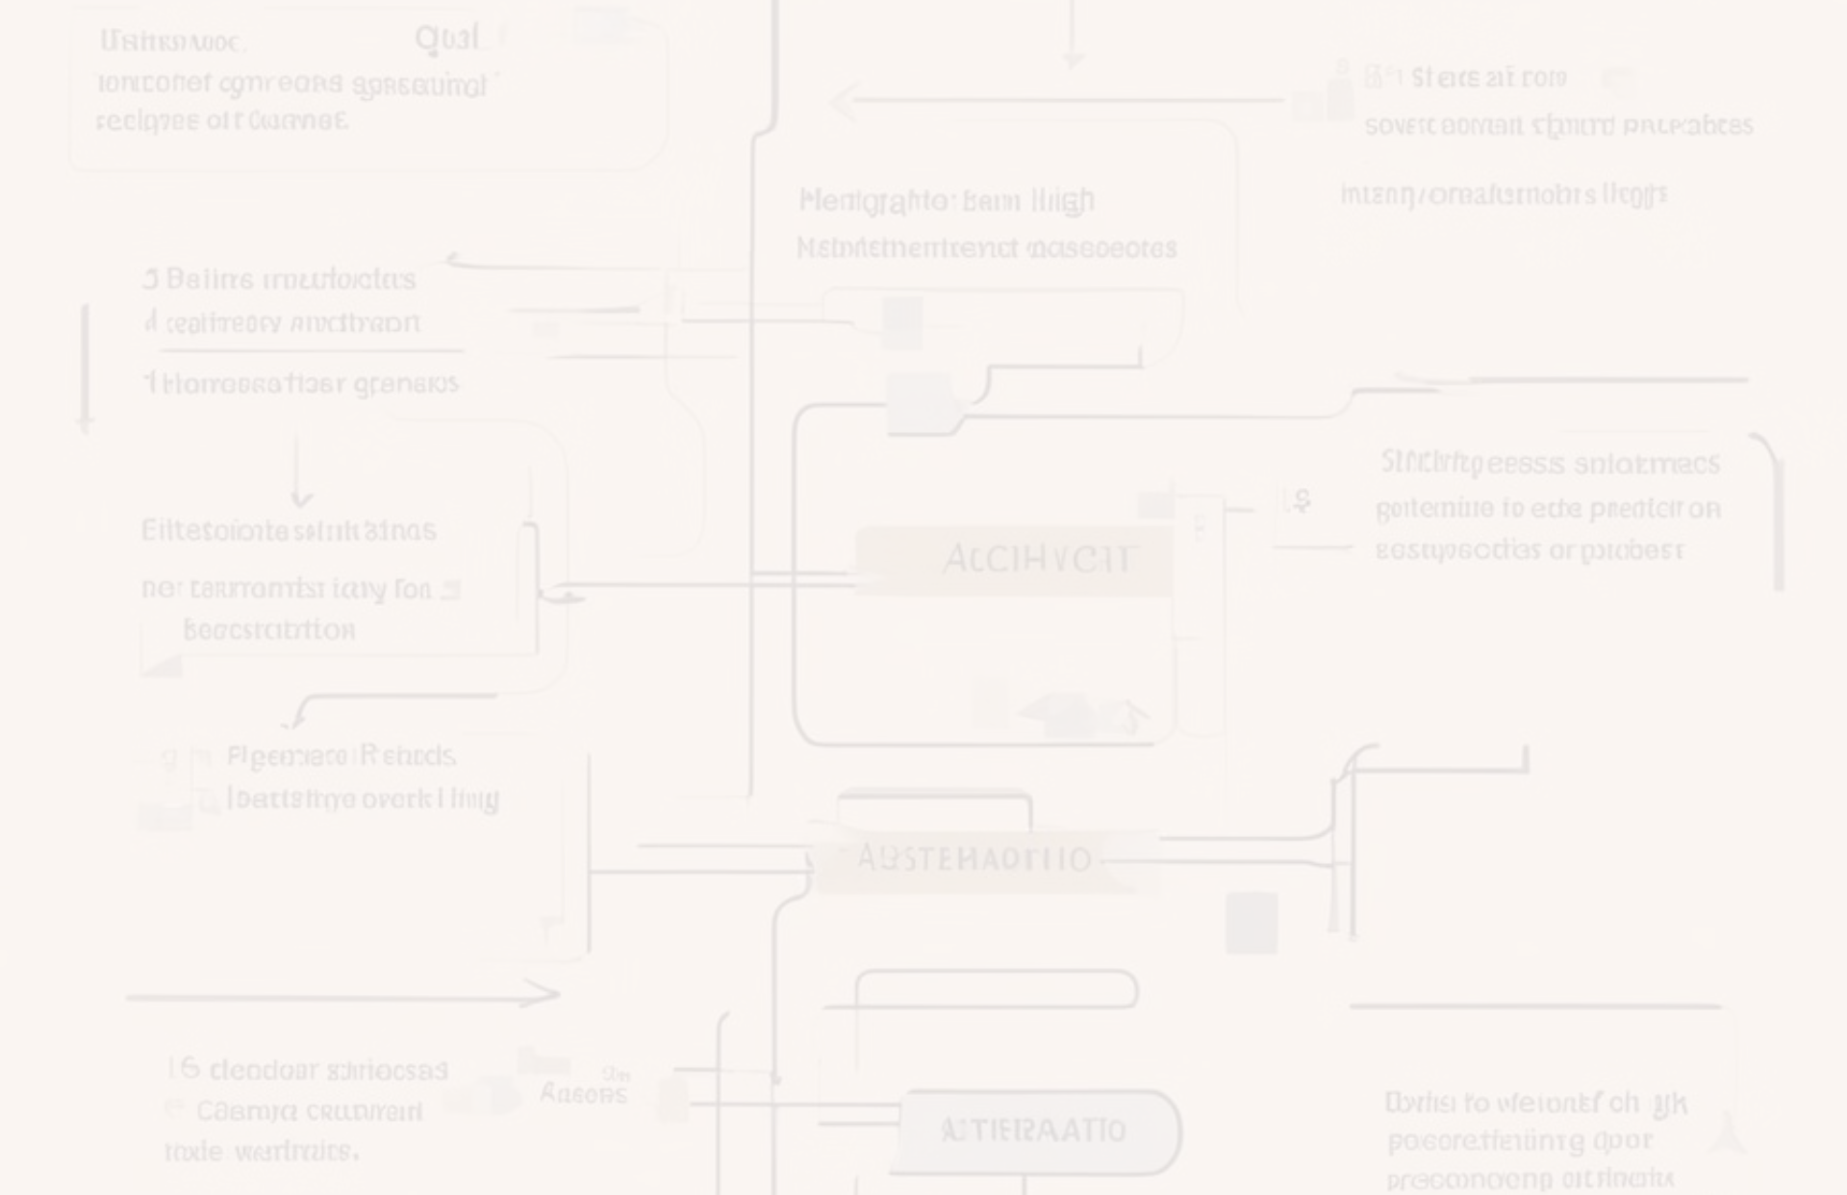






Methodology
User Authentication
Secure login for teachers and students.
Quiz Creation
Teachers can create quizzes with various question types.
Quiz Taking
Students can take quizzes online.
Automatic Grading
Immediate feedback for students and time-saving for teachers.
Leaderboard
Optional feature to encourage student engagement.
Adaptive Learning
Optional feature to customize quiz difficulty based on student performance.

Slide 7



Advantages
For Teachers
For Students
For Institutions
Save time, track progress, and create diverse quizzes effortlessly.
Convenient quizzes and immediate feedback for an enhanced learning journey.
Enhanced efficiency and valuable data insights for continual improvement.

Slide 8

Tech Skills
1
Frontend
2
Backend
3
Database
Utilizing HTML, CSS, JavaScript for the platform's user interface and interaction.
Implementing Java for server-side logic to ensure efficient platform functionality.
Utilizing Database for secure and efficient data storage and management.

Slide 9

Conclusion
1
Modernizing Education
2
Enhancing Efficiency
Revolutionizing exam processes and enhancing student engagement.
Improving teacher productivity and providing personalized learning experiences.

Slide 10

Thank You
Thank you for your attention. We are now open for any questions or suggestions.

